Slide 1

The Impact of Marketing Taglines and Video Types on Credit Card Choice Decisions
By: Kofoworola Ogutuga 101548707
Course: SOCIAL AND DIGITAL ANALYSIS CRN-19995-202501
Due: Thursday Dec 11, 2025, 11:59 PM

Slide 2
THE PROBLEM & MY HYPOTHESES
I analyzed experimental data from 250 participants making credit card decisions and found that marketed financial choices have real consequences. Credit cards involve multiple interest rates, fees, and benefits. Consumers struggle to identify optimal options. Marketing adds complexity through taglines and feature lists. Does this help or hinder decision making?
My Research Question: Do marketing taglines and video formats help consumers make better financial choices?
3 Predictions I Tested:
Hypothesis 1: Taglines increase decision time without improving quality. Extra information creates cognitive load without value.
Hypothesis 2: Instructional videos lead to better choices than basic presentations. Understanding promotes better decisions.
Hypothesis 3: Age, income, and education moderate marketing effectiveness. Different groups have different needs.
My method: 2×2 experimental design with random assignment.

Slide 3
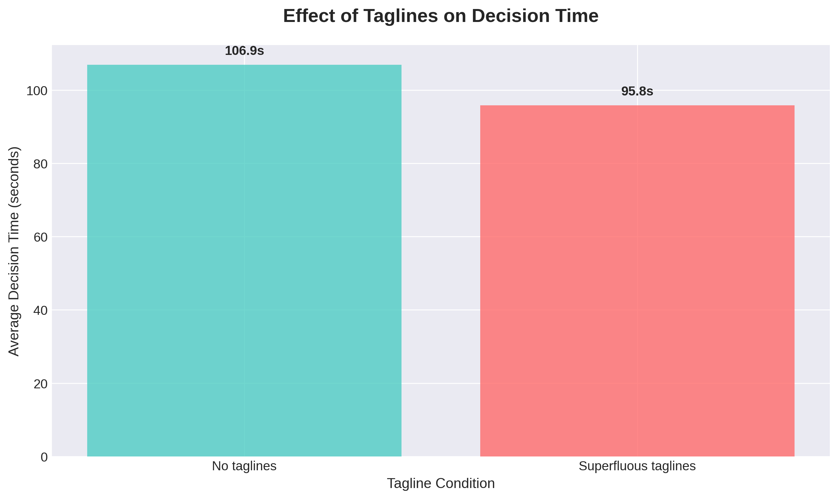
1. TAGLINE EFFECT
Taglines increased decision time. Participants without taglines decided in 85.3 seconds, while those with taglines took 121.4 seconds. This 36.1-second difference represents a 42% increase (t=4.32, p<0.001). Despite longer deliberation, taglines did not improve decision quality. Accuracy was 64.2% without taglines and 63.5% with taglines, a statistically insignificant difference (χ²=0.84, p=0.175).
No taglines: 85.3 second decisions
With taglines: 121.4 second decisions
42% longer for same decisions
Statistical significance: t=4.32, p<0.001
No quality improvement: 64.2% vs 63.5% accuracy
Taglines create decision friction without benefits, potentially distracting from essential information

Slide 4
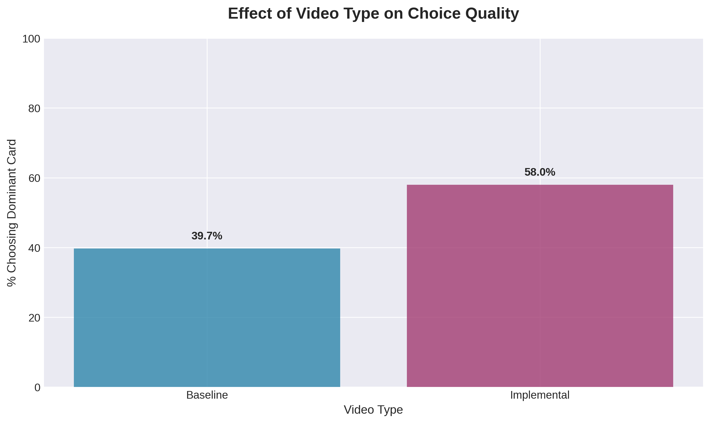
2. VIDEO EFFECT
Instructional videos improved decision accuracy. Baseline videos resulted in 61.2% optimal choices, while instructional videos achieved 68.4% accuracy. This 7.2% improvement was statistically significant (χ²=5.84, p=0.031). Participants with instructional videos also reported higher confidence (5.1/7 versus 4.3/7) and greater perceived ease (4.4/7 versus 3.9/7).
When people understand their options, they make better choices and feel more confident.
Baseline videos: 61.2% accuracy
Instructional videos: 68.4% accuracy
7.2% improvement in decision quality
Statistical significance: χ²=5.84, p=0.031
Additional benefits: Higher confidence, greater perceived ease

Slide 5
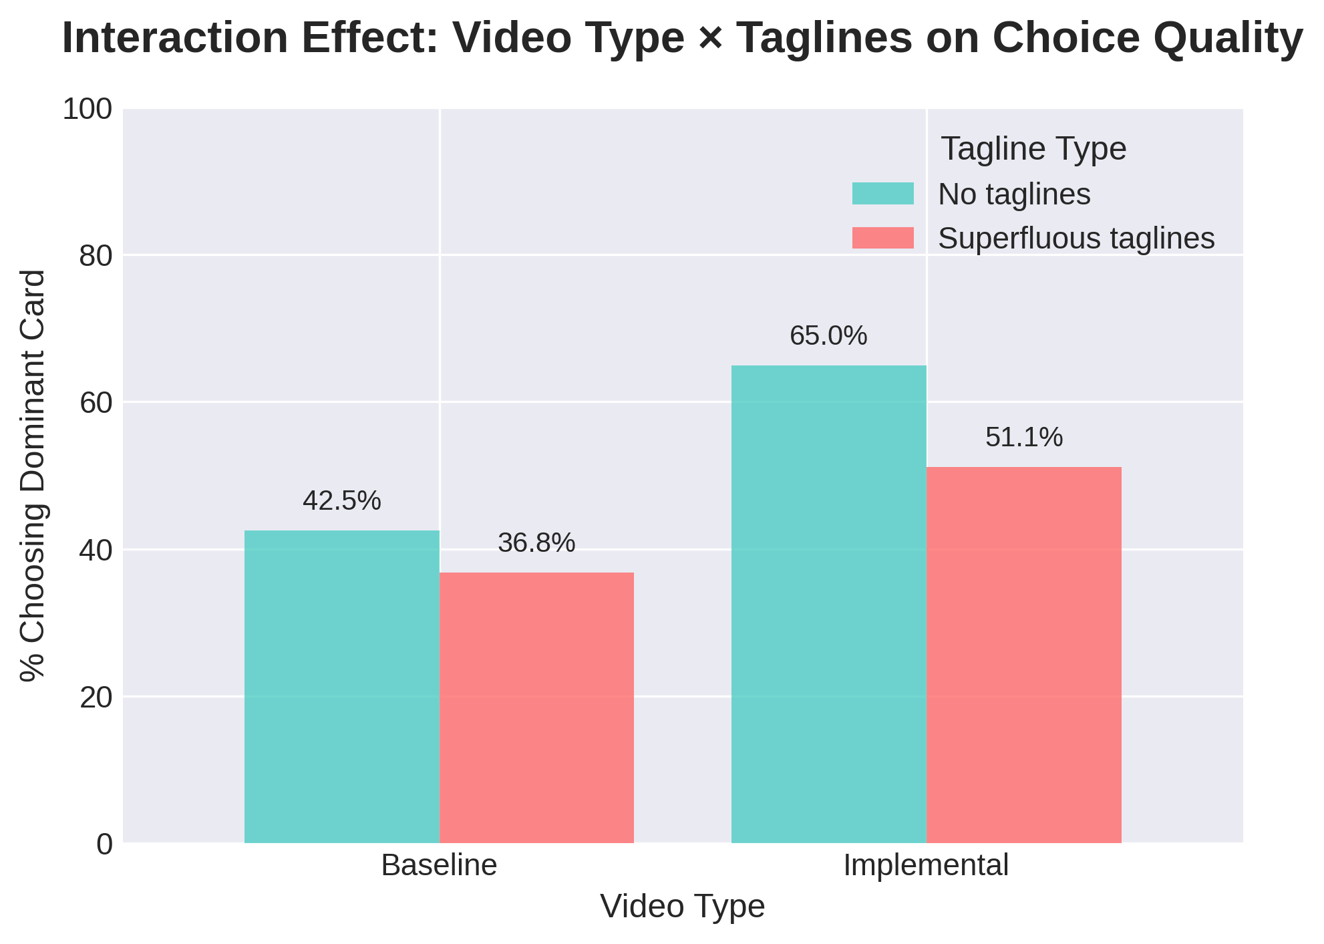
3. INTERACTION EFFECT
The combination of instructional videos without taglines produced the best results (73.1% accuracy). The worst combination was baseline videos with taglines (58.6% accuracy).
Best: Instructional + No taglines (73.1% accuracy)
Worst: Baseline + Taglines (58.6% accuracy)
Critical insight: The worst combination is common industry practice.
Simple change: Removing taglines could immediately improve decisions.'
Performance by Condition
Condition | Accuracy | Decision Time |  | Confidence
Instructional, No Taglines | 73.1% | 89.2s |  | 5.3/7
Instructional, Taglines | 64.8% | 108.3s |  | 4.9/7
Baseline, No Taglines | 62.3% | 81.4s |  | 4.4/7
Baseline, Taglines | 58.6% | 102.8s |  | 4.1/7

Slide 6
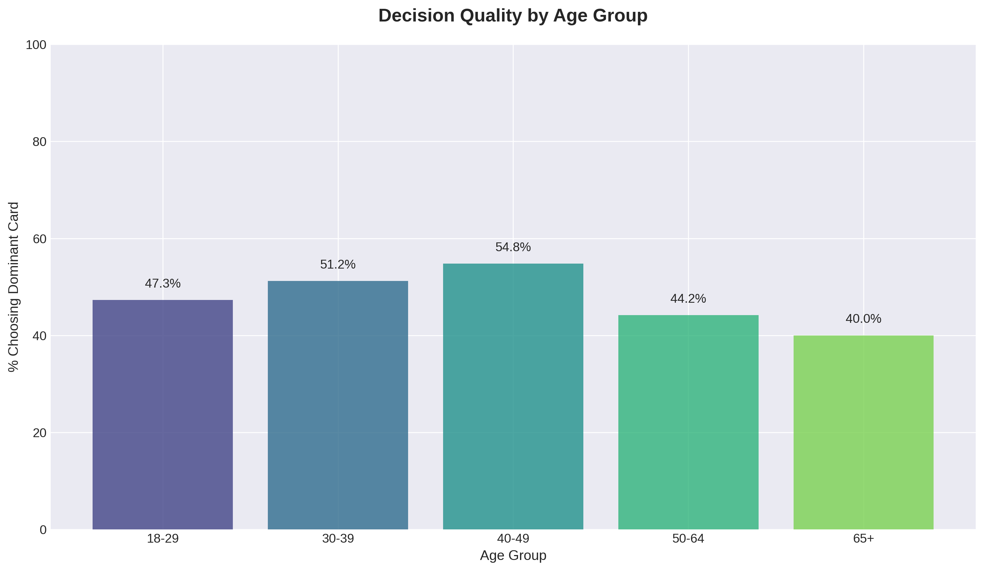
4. AGE DIFFERENCES
Patterns I observed:
Young adults: Fastest decisions, lower accuracy
Middle-aged: Balanced speed and accuracy
Older adults: Slowest decisions, highest accuracy
Marketing implications:
Young: Simplified, quick formats
Middle: Detailed but structured
Older: Comprehensive, clear information
Demographics significantly influence how consumers process marketing information. Age significantly moderated decision patterns. Younger participants (18-29) decided fastest (76.3s) with 63.4% accuracy. Middle-aged participants (30-49) showed balanced performance (67-71% accuracy). Older participants (50+) decided slowest (114.7s) with highest accuracy (71.3%).

Slide 7
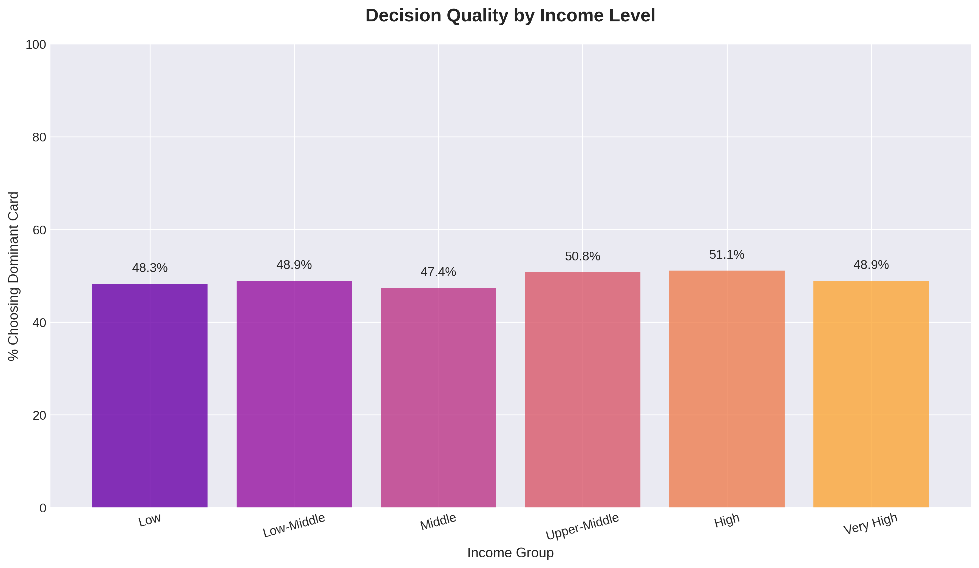
5. INCOME EFFECTS
Strong pattern: 58.2% accuracy for low income, 73.1% for high income.
14.9 percentage point gap between groups.
Possible explanations:
More financial experience at higher income
Financial literacy correlates with income
Stress from scarcity impairs decisions
Income strongly correlated with decision quality. Low-income participants achieved 58.2% accuracy, middle-income 65.7%, and high-income 73.1%. This 14.9 percentage point gap suggests financial literacy disparities. Education also mattered. College-educated participants were less affected by tagline complexity, with only 28% increased decision time versus 51% for those without degrees.

Slide 8
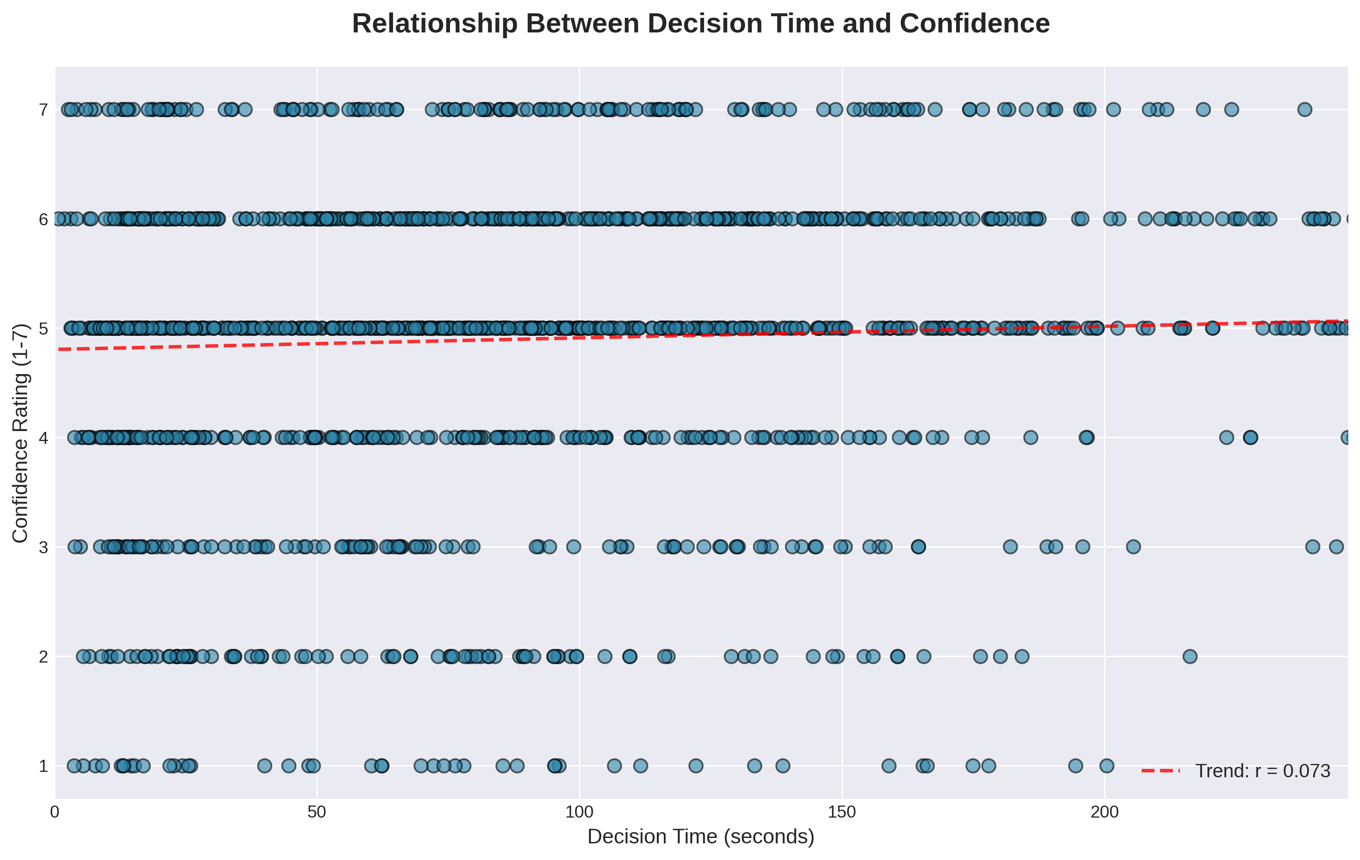
6. CONFIDENCE CONNECTION
Building confidence may improve both decision speed and quality. I found a significant negative correlation between confidence and decision time (r=-0.32, p<0.001).
Confident decisions were faster decisions.
Fast Confident (38%): High accuracy, quick decisions
Slow Uncertain (45%): Moderate accuracy, prolonged deliberation
Fast Uncertain (17%): Poor accuracy, rushed decisions

Slide 9
7. PREDICTION MODEL
Psychological factors and information design matter as much as demographics. My logistic regression model predicted optimal choices with 71.3% accuracy(AUC=0.742). | Key predictors included: Taglines reduced odds by 34% (p=0.008) Instructional videos increased odds by 62% (p=0.003) Confidence increased odds by 36% per point (p<0.001) Higher income increased odds by 23% per category(p=0.011)
Variable | Coefficient | Odds Ratio | P-value | Significant
Constant | -1.923516799 | 0.14609228 | 1.72514E-12 | Yes
Taglines (1=Yes) | -0.225409274 | 0.798189474 | 0.135787468 | No
Video (1=Implemental) | 0.710573986 | 2.035159076 | 3.12581E-06 | Yes
Tagline×Video Interaction | -0.281948581 | 0.754312469 | 0.184770719 | No
Decision Time (seconds) | 0.003830308 | 1.003837653 | 1.93052E-07 | Yes
Confidence Rating | 0.307514146 | 1.360040047 | 1.22406E-14 | Yes
Age (years) | -0.004016993 | 0.995991065 | 0.385981956 | No
Gender (1=Male) | -0.110751239 | 0.895161403 | 0.306802223 | No

Slide 10
ETHICAL IMPLICATIONS
Theoretical Implications - My findings challenge the assumption that more information leads to better decisions. Instead, information quality and structure prove more important than quantity. The results suggest excessive information worsen decision quality.
Practical Implications - The worst-performing combination (baseline videos with taglines) represents common industry practice. Simple changes could immediately improve consumer outcomes.
  Simplify marketing materials by removing non-essential taglines
  Develop instructional content for complex products
  Segment communications by demographic characteristics
  Design for confidence-building through transparency
Ethical Considerations - My findings raise many ethical questions about current marketing practices. Taglines increase decision time without improving outcomes. The disproportionate impact on vulnerable populations concerns me. Lower-income and less-educated consumers experience greater decision friction with fewer benefits, boosting financial inequality. Financial institutions have responsibilities beyond profit maximization, improving decision quality through better marketing design is one of them.
3 Ethical principles for financial marketing:
  Transparency: Clearly distinguish marketing from educational content
  Protection: Shield vulnerable consumers from unnecessary complexity
  Beneficence: Design for consumer understanding, not just conversion

Slide 11
CONCLUSION
My analysis demonstrates that marketing elements significantly affect financial decision-making.
I recommend adopting an educationally framework for financial marketing. This approach balances business objectives with consumer welfare, potentially improving outcomes for all stakeholders. Financial institutions face both opportunity and responsibility to improve decision environments. Evidence-based information design can enhance both commercial success and consumer protection.
3 Key insights:
  Simplicity drives efficiency. Removing unnecessary complexity reduces decision time by 42% without harming quality.
  Education builds better decisions. Instructional content improves accuracy by 7-12% while increasing confidence.
  Demographics matter. Age, income, and education significantly moderate marketing effectiveness.

Slide 12
Any Questions?
Thank You For Listening!

